Slide 1
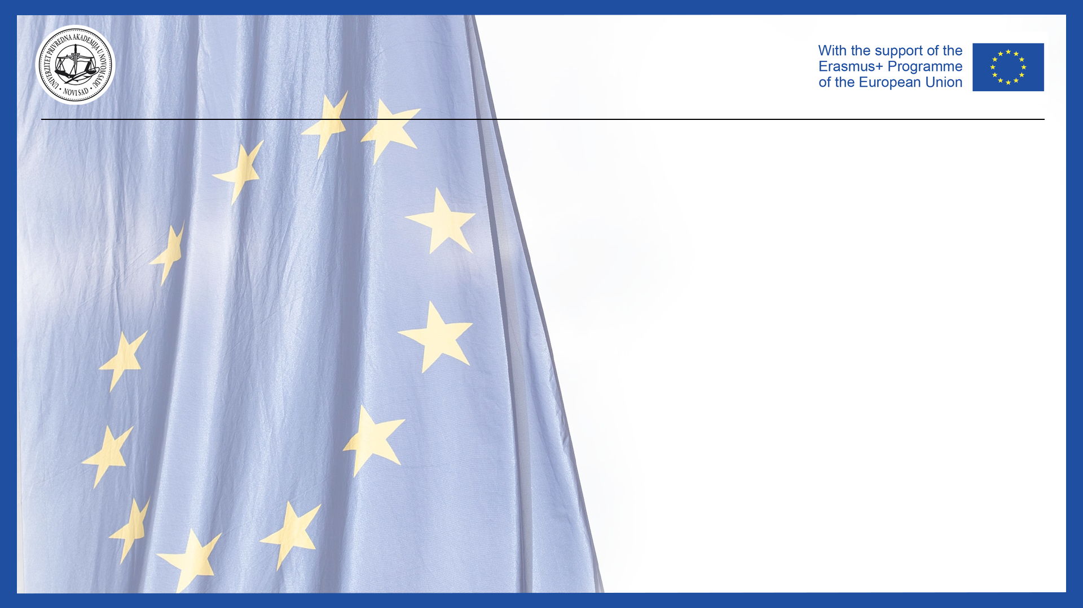
Jean Monnet Module
Application of EU values in the policies of candidate states / AEUPCS
Jelena Vapa Tankosić
Trade relations between Western Balkans countries and the EU

Slide 2
Trade relations between Western Balkans countries and the EU
In April 1997, the European Union adopted a regional approach policy for the countries of the Western Balkans, which set the political and economic conditions for starting bilateral cooperation with these countries.
The approach was complemented by the May 1999 initiative when the EC adopted the Stabilization and Association Process
The Stabilization and Association Process is in part similar to the Agreements under which the accession of Central and Eastern European countries was carried out, but is also characterized by significant differences in relation to the rights and obligations of the signatory states and the EU itself.

Slide 3
Trade relations between Western Balkans countries and the EU
The countries of the Western Balkans have undertaken to cooperate on a regional basis, which should ensure the long-term stability of the region.
In 1999, the EC established principles for the further development of the region, which is reflected in the Stabilization and Association Process.
All the countries of the Western Balkans were given the possibility of future membership in the European Union, a goal that was supported by the European Council in Feira in June 2000 and confirmed by the European Council in Thessaloniki in June 2003.

Slide 4
Trade relations between Western Balkans countries and the EU
In January 2006, the European Commission adopted the "Communication on the Western Balkans on the Road to the European Union: Consolidating Stability and Raising Prosperity".
The Communication sets out concrete measures to strengthen EU policy for the Western Balkans and its instruments.
SAA is a type of contractual relationship with the European Union, which offers the countries of the Western Balkans a more certain European perspective in exchange for fulfilling the appropriate preconditions.
The framework for trade co-operation in the Western Balkans is provided by the CEFTA and the SAA.

Slide 5
Discssion: Trade relations between Western Balkans countries and the EU
For all of the Western Balkan partners, the EU is the leading trade partner accounting for almost 70% of the region's total trade; while the region's share of overall EU trade is only 1.4%.
Trade with the region has grown by almost 130% over the past 10 years, with the total trade between the EU and the Western Balkans reaching EUR 55 billion in 2019.
WB increased its exports to the EU by 207% against a more modest increase of EU exports to the region of 94%.

