Slide 1

Jean Monnet Module
Application of EU values in the policies of candidate states / AEUPCS
Jelena Vapa Tankosić
Trade Agreements with third countries

Slide 2
Trade Agreements with third countries
Trade relations with third countries in the form of trade agreements
Trade benefits:
opening new markets for EU goods and services
increasing investment opportunities and protection of investments
making trade cheaper by eliminating customs duties and cutting red tape
making trade faster by facilitating transit through customs and setting common rules.

Slide 3
Trade agreements
Economic Partnership Agreements (EPAs) - support development of trade partners from African, Caribbean and Pacific countries
Free Trade Agreements (FTAs) - enable reciprocal market opening with developed countries and emerging economies by granting preferential access to markets
Association Agreements (AAs) - boster broader political agreements
The EU also enters into non-preferential trade agreements, as part of broader deals such as Partnership and Cooperation Agreements (PCAs).

Slide 4
Economic Partnership Agreements (EPAs)
Seven Economic Partnership Agreements with 32 countries
14 Caribbean countries, 14 African countries and 4 Pacific countries
WTO compatible
EPA partners pay no duties or tariffs for export to EU
They open their market partially to EU
EPA have flexible rules of origin

Slide 5
Free Trade Agreements (FTAs)
The EU has 45 trade agreements with individual countries or with other free trade areas
And among themselves EFTA
Aim: to reduce barriers in trade and promote trade and investment

Slide 6
Association Agreements (AAs)
The legal basis for their conclusion is Article 217 TFEU
„The Union may conclude with one or more third countries or international organisations agreements establishing an association involving reciprocal rights and obligations, common action and special procedure“
to establish close economic and political cooperation
more privileged relationship between the EC and its partner (from more than a free trade agreement up to a level of integration such as membership)

Slide 7
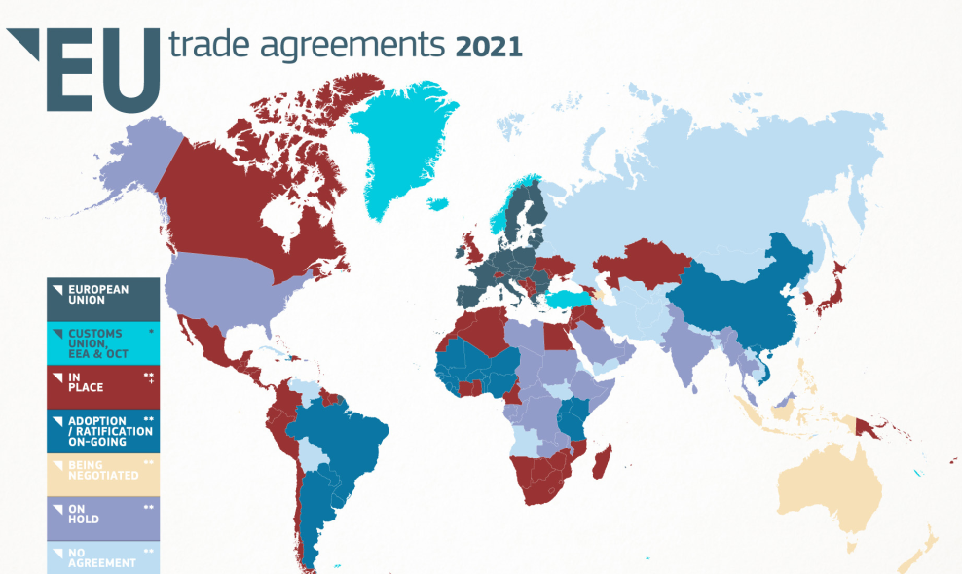
Discussion: Trade Agreements with third countries

