Slide 1
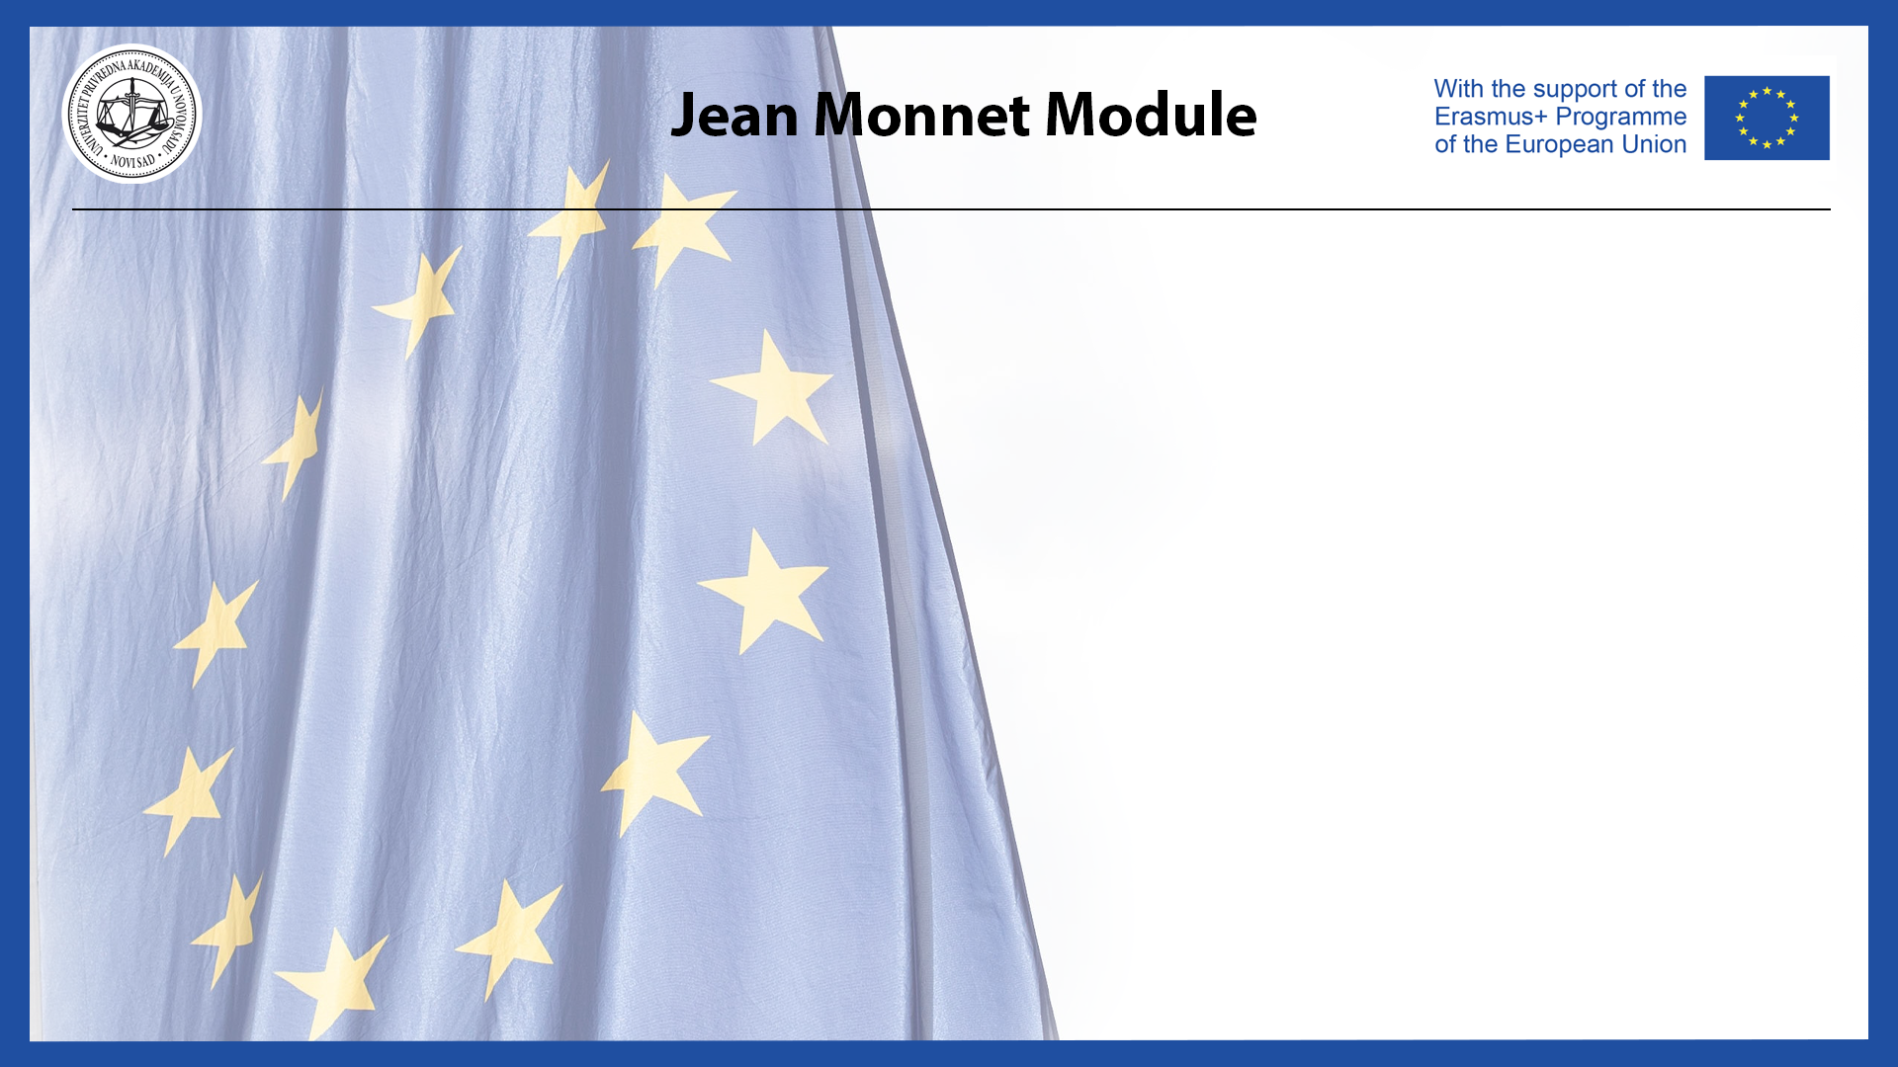
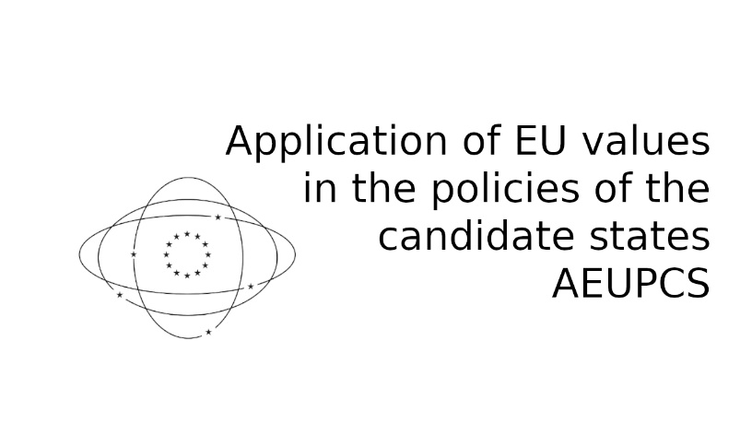
Human Rights and Climate Change within the EU Legal Framework

Slide 2
International Agreements on Climate Change
Doc. dr Marijana Mladenov

Slide 3
UN Framework Convention on Climate Change (UNFCCC), 1992
Kyoto Protocol, adopted in 1997 and entered into force in 2005
Paris Agreement, 2015.

Slide 4
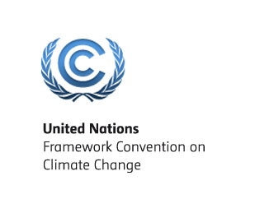
UN Framework Convention on Climate Change
Ratified by 197 countries
the first global treaty that explicitly addressed climate change
The ultimate objective of the Convention is to stabilize greenhouse gas concentrations "at a level that would prevent dangerous anthropogenic (human induced) interference with the climate system."

Slide 5
the Kyoto Protocol operationalizes the United Nations Framework Convention on Climate Change by committing industrialized countries and economies in transition to limit and reduce greenhouse gases (GHG) emissions in accordance with agreed individual targets
In its Annex B the Kyoto Protocol sets binding emission reduction targets for 37 industrialized countries and economies in transition and the European Union.
the Doha Amendment
KYOTO PROTOCOL TO THE UNITED NATIONS FRAMEWORK CONVENTION ON CLIMATE CHANGE

Slide 6
THE PARIS AGREEMENT
The Paris Agreement sets out a global framework to avoid dangerous climate change by limiting global warming to well below 2°C and pursuing efforts to limit it to 1.5°C.
The Paris Agreement is the first-ever universal, legally binding global climate change agreement, adopted at the Paris climate conference (COP21) in December 2015.
The EU and its Member States are among the close to 190 Parties to the Paris Agreement. The EU formally ratified the agreement on 5 October 2016, thus enabling its entry into force on 4 November 2016. For the agreement to enter into force, at least 55 countries representing at least 55% of global emissions had to deposit their instruments of ratification.
Katowice rulebook
Global Climate Action Agenda

Slide 7
EU's role
The EU has been at the forefront of international efforts to fight climate change. It was instrumental in brokering the Paris Agreement and continues to show global leadership.
In December 2020, the EU submitted its updated and enhanced NDC the target to reduce emissions by at least 55% by 2030 from 1990 levels, and information to facilitate clarity, transparency and understanding (ICTU) of the NDC.
The EU’s initial nationally determined contribution (NDC) under the Paris Agreement was the commitment to reduce greenhouse gas emissions by at least 40% by 2030 compared to 1990, under its wider 2030 climate and energy framework. All key EU legislation for implementing this target was adopted by the end of 2018.

Slide 8
EU climate action and the European Green Deal
European Climate Law to enshrine the 2050 climate-neutrality objective into EU law
European Climate Pact to engage citizens and all parts of society in climate action
2030 Climate Target Plan to further reduce net greenhouse gas emissions by at least 55% by 2030
New EU Strategy on Climate Adaptation to make Europe a climate-resilient society by 2050, fully adapted to the unavoidable impacts of climate change.
EU Emissions Trading System (EU ETS) to reduce greenhouse gas emissions from the power sector, industry and flights within the EU.
Statistics on climate change (Eurostat)

Slide 9
Future of the Paris Agreement?
Discussion topic

Slide 10


Email
alavuk@pravni-fakultet.info
marijana.mladenov@privrednaakademija.edu.rs

