Slide 1


Human Rights and Climate Change within the EU Legal Framework

Slide 2
The Human Rights Implications of Climate Change
Doc. dr Marijana Mladenov

Slide 3
“CLIMATE CHANGE IS AN URGENT GLOBAL PROBLEM REQUIRING A GLOBAL SOLUTION.”
the United Nations Human Rights Council’s Resolution 26/27

Slide 4
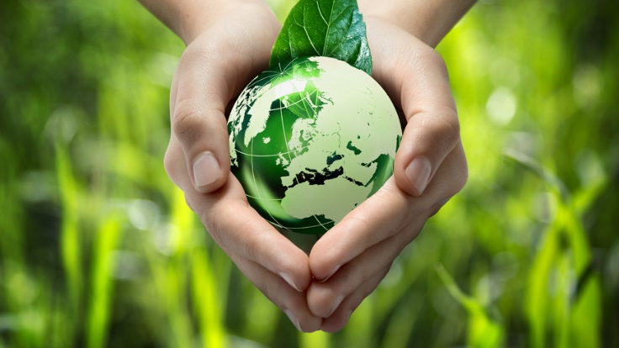
INTERNATIONAL CLIMATE CHANGE LAW
INTERNATIONAL ENVIRONMENTAL LAW
INTERNATIONAL HUMAN RIGHTS LAW
INTERNATIONAL ENVIRONMENTAL LAW

Slide 5
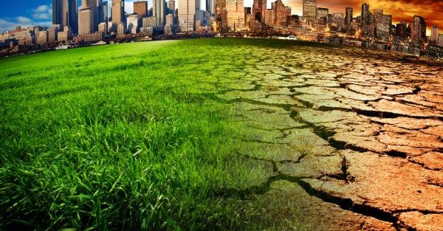
Climate change poses an enormous threat to the lives and well-being of individuals and communities across the world
Climate change is already contributing to drought, ecosystem degradation, and food shortages across the world
The nature of the linkages between the environment and human rights has been debated for years
The United Nations agencies and national governments have explicitly acknowledged that climate change and responses to climate change can impair human rights, however there has been less agreement on the corresponding obligations of governments and private actors to address this problem

Slide 6
Climate change threatens the effective enjoyment of a range of human rights including:
the right to life
the right to health
the right to food
the right to water and sanitation
the right to protection of private and family life
the right to property
the right to development
the right to an adequate standard of living

Slide 7

OHCHR’s Key Messages on Human Rights and Climate Change at the 21st Conference of the Parties to the United Nations Framework Convention on Climate Change
To mitigate climate change and to prevent its negative human rights impacts
To ensure that all persons have the necessary capacity to adapt to climate change
To ensure accountability and effective remedy for human rights harms caused by climate change
To mobilize maximum available resources for sustainable, human rights-based development
International cooperation
6. To ensure equity in climate action:
7. To guarantee that everyone enjoys the benefits of science and its applications
8. To protect human rights from business harms
9. To guarantee equality and non-discrimination
10. To ensure meaningful and informed participation

Slide 8
Right to an adequate environment
Universal Human Rights Instruments
Regional Human Rights Instruments

Slide 9
RIGHT TO AN ADEQUATE ENVIRONMENT
Everyone should be able to live in an environment conducive for their health and well-being.
States should take concrete and progressive steps, individually and in cooperation with each other, to develop, implement and maintain appropriate frameworks to enable all components necessary for a healthy, sustainable environment, which encompasses all parts of the natural world. This includes the regulation of corporate and other private actors in their domestic and extraterritorial operations.
CLIMATE CHANGE

Slide 10
What does climate change have to do with human rights?
Discussion topic

Slide 11


Email
alavuk@pravni-fakultet.info
marijana.mladenov@privrednaakademija.edu.rs

