Slide 1

Jean Monnet Module
Application of EU values in the policies of candidate states / AEUPCS
Jelena Vapa Tankosić
Progress of EU integration

Slide 2
Progress of EU integration
The biggest enlargement in 2004 to EU15.
Bulgaria and Romania joined in January 2007, Croatia in 2013.
Even when the new members are fully and successfully integrated, large differences in the levels of economic development, standard, economic structure, culture and customs do not cease to exist immediately.

Slide 3
EU enlargement
Within European studies, theoretical approaches dedicated to EU enlargement developed around 3 issues (Schimmelfennig & Sedelmeier 2002: 504-507):
political action of candidate countries (why and under what conditions do non-members want to join a regional organization?);
political action by member states (under what conditions do member states of a regional organization advocate or oppose a country's candidacy?);
the political action of the European Union (under what conditions does a regional organization accept new members or change its institutional relations with a third country?).

Slide 4
European integrations
European integrations have always been based on political factors, but their implementation has been based on economic principles.
From the establishment of a customs union, the abolition of quotas and tariffs on trade, the creation of a single market, the abolition of non-tariff barriers and the liberalized movement of capital within the EU.
The first incentives for deeper integration, ie. to create a monetary union were also launched in the 1970s.
Introduction of euro in 2002.

Slide 5
Progress of EU integration
Any European country that respects EU values ​​and is committed to promoting them can apply to become a member of the Union. Likewise, any Member State may decide to withdraw from the Union.
The old member states of the Union (EU15) have benefited from new enlargements in which the EU single market has increased
improved trade and investment opportunities, encouraged EU companies to take advantage of new business opportunities, become more efficient and thus more competitive on the world markets.

Slide 6
Waves of EU enlargement
1952 - EU 6 (Belgium, Germany, France, Italy, Luxembourg, Netherlands-ECSC)
1973 - EU 9 (Denmark, Ireland, United Kingdom)
1981 - EU 10 (Greece)
1986 - EU 12 (Spain, Portugal)
1995 - EU 15 (Austria, Sweden, Finland)
2004 - EU 25 Malta, Cyprus + Czech Republic, Estonia, Hungary, Latvia, Lithuania, Poland, Slovenia, Slovakia (eight transition countries)
2007 - EU 27 (Romania, Bulgaria)
2013 - EU 28 (Croatia)

Slide 7
Progress of EU integration
From the enlargement in 2013 the EU has stopped the integration process and its intensity, and to a large extent called into question the dynamics of further planned enlargements;
EU can not in a short time integrate new members, and to maintain the set goals of integration.
The benefits of a larger EU economic space still exist.

Slide 8
Progress of EU integration
The process of European integration began as the dominant international political and security solution.
Each new enlargement brought new challenges.
The beginning of integration, from a successful customs union, and through a hard-to-create common and single market, to a monetary and economic union.
Higher levels of integration, and enlargements to new members, may make the EU's internal functioning more difficult.

Slide 9
EU integration of the Western Balkans
When it comes to the degree of EU integration of the Western Balkans, the countries have signed a Stabilization and Association Agreement
Accession negotiations are progressing well with Serbia and Montenegro, which are largely implementing reforms and aligning its legislation with the acquis communautaire.
In April 2018, the Commission recommended that the Council open accession negotiations with Northern Macedonia and Albania, given the progress made in the reform process.

Slide 10
EU integration of the Western Balkans
The integration of the Western Balkans region and the overall reform processes in its constituent countries have been greatly aided by EU technical and financial assistance through various instruments.
Pre-accession funds represent a significant investment for Western Balkans.
EU helps beneficiaries achieve comprehensive political and economic reforms, preparing them for the rights and obligations that come with EU membership.
EU is a leading trading partner of the Western Balkan countries and, with more than two thirds of total foreign direct investment, a leading investor in the region.

Slide 11
EU integration of the Western Balkans
The Republic of Serbia submitted a request for full membership in the EU in December 2010.
In October 2011, the EC gave a positive recommendation to be granted candidate status.
On March 1, 2012, the European Council decided to grant the Republic of Serbia the status of a candidate for membership in the European Union.
In 2013, the Stabilization and Association Agreement between the Republic of Serbia and the European Union entered into force.
In the same year, the European Council adopted a negotiating framework with Serbia and decided to hold the First Intergovernmental Conference with Serbia in January 2014. At the second intergovernmental conference on Serbia's accession to the EU, the first two of a total of 35 negotiating chapters were opened.
So far, Serbia has opened 18 of the 35 chapters, two of which have been temporarily closed. This year none of the chapters have been opened.

Slide 12
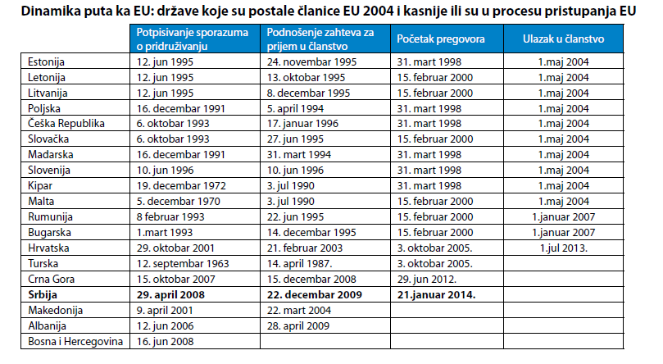
EU membership negotiations
Izvor: Budimir, B. Međak (2017). Vodič kroz pristupanje Srbije Evropskoj uniji, 5. dopunjeno izd., Beograd : ISAC fond, str.56.

Slide 13
EU integration of the Western Balkans
Uncertain dynamics of further EU enlargement must be taken into account.
Candidate status can last a very long time.
Negotiations on EU membership have up till now taken an average of 5 to 7 years, but there is no time limit on how long they can last.
The duration of negotiations depends on the ability of the state to harmonize its legislation with the acquis communautaire during the negotiations, but also on the political readiness of the EU to accept a new member state.

Slide 14
Further reading
Schimmelfennig, F, Sedelmeier, U. (2002) ‘Theorizing EU enlargement: research focus, hypotheses, and the state of research’, Journal of European Public Policy, (9) 4, 500-528.
Baldwin, R., Wyplosz, C. (2004). The Economics of European Integration, McGrawHill, London.
Senior Nello, S. (2009). The European Union: Economics, Policy and History, McGraw-Hill, London.
Jovanović, M. (2004). Evropska ekonomska integracija, Ekonomski fakultet u Beogradu, Beograd.
Budimir, B. Međak (2017). Vodič kroz pristupanje Srbije Evropskoj uniji, 5. dopunjeno izd., ISAC fond, Beograd.

Slide 15
Further reading
Medović, V., Vapa-Tankosić, J. (2017). Izazovi u primeni Sporazuma o stabilizaciji i pridruživanju i pravnih tekovina Evropske unije, Fakultet za ekonomiju i inženjerski menadžment, Novi Sad. ISBN 978-86-87619-90-6, UDK 341.217.02(4-672EU:497.11).
Lane, D. (2007). Post-Communist States and the European Union, Journal of Communist Studies and Transition Politics, 23(4), 461-477, DOI: 10.1080/13523270701674558
European Commission (2009). Five years of an enlarged EU: Economic achievements and challenges, European Economy 1/2009, European Commission, Directorate-General for Economic and Financial Affairs, Brussels.

