Slide 1

Jean Monnet Module
Application of EU values in the policies of candidate states / AEUPCS
Jelena Vapa Tankosić
New regional initiatives

Slide 2
New regional initiatives
The Berlin Process is an initiative whose main task is to maintain the momentum of European integration in the Western Balkans.
Initially limited in time (2014 - 2018) and scope, it expanded and became a multisectoral process without a term.
The goal to advance the "EU agenda" in three dimensions: economic growth and connectivity, good neighborly relations and regional cooperation, development of civil society and interconnection among people.
It started with the 2014 Berlin Conference, which was followed by the 2015 Vienna Summit, the 2016 Paris Summit, the 2017 Trieste Summit the 2018 London Summit, the 2019 Poznan Summit, the 2020 Sofia Summit.

Slide 3
New regional initiatives
Connectivity Agenda for Western Balkans
Developing Common Regional Market based on four freedoms, the same as the EU single Market, strengthened with Investment, Digital, Industry and Innovation.
Regional Economic Area in the Western Balkans.
The Multi-annual Action Plan for a Regional Economic Area in the Western Balkans Six (MAP) adopted on 12th July 2017 at the occasion of the Trieste Western Balkan Summit.

Slide 4
New regional initiatives
The MAP itself encompasses four sectors through the improvement of which the basis for the establishment of a regional economic space is planned to be achieved: trade, investments, mobility and the digital market.
This initiative is designed as a process that unequivocally contributes to reviving the dynamics of integration by supporting the implementation of European rules and standards at the regional level.

Slide 5
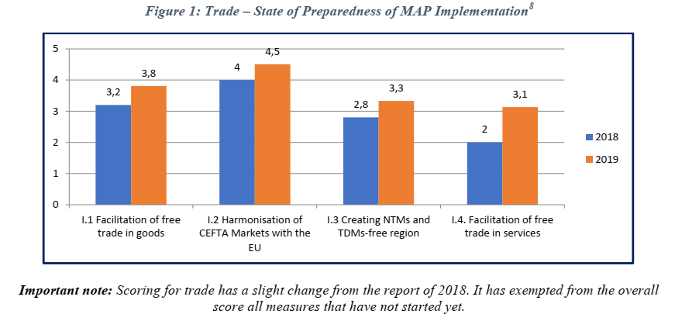
Regional assessment of the implementation of MAP REA measures
Source: Annual report on implementation of the Multi-annual Action Plan for a Regional Economic Area (Map Rea) In Western Balkans

Slide 6
Further reading for discussion
Annual Report on Implementation of the Multi-Annual Action Plan for a Regional Economic Area in Western Balkans”, https://www.rcc.int/docs/478/annual-report-on-implementation-of-the-multi-annual-action-plan-for-a-regional-economic-area-map-rea-in-western-balkans-wb
Bjelić, P., Dragutinović, Mitrović, R. (2018). Unapređenje pozicije Srbije u okviru CEFTA 2006, FREN – Fondacija za razvoj ekonomske nauke, Beograd.

Slide 7
Further reading
Medović, V., Vapa-Tankosić, J. (2017). Izazovi u primeni Sporazuma o stabilizaciji i pridruživanju i pravnih tekovina Evropske unije, Fakultet za ekonomiju i inženjerski menadžment, Novi Sad. ISBN 978-86-87619-90-6.
Medjak, V. (ed.). (2018). Effects of Stabilisation and Association Agreements and CEFTA2006 on WB6 European Integrationand Regional Cooperation: Achievements and Ways Forward. European Movement in Serbia, Belgrade.
European Commission, Serbia 2019 Report, 2019, https://ec.europa.eu/neighbourhood-enlargement/sites/near/files/20190529-serbia-report.pdf

