Slide 1

Jean Monnet Module
Application of EU values in the policies of candidate states / AEUPCS
Jelena Vapa Tankosić
Economic aspects of Stabilization and Association process

Slide 2
Economic aspects of Stabilization and Association process
The process of European integration is a political process, but much more, the reform of the entire society to achieve the legal, economic, technological, scientific and other standards that apply in the EU.
SAA between Serbia and the EU entered into force in September 2013.
Aim: to establish a free trade zone and align domestic legislation with the EU.
Serbia and the EU have already achieved a very high level of trade integration through the implementation of the Interim Agreement, which covers trade and trade-related issues, which Serbia has applied voluntarily since January 2009 and which officially entered into force in February 2010.

Slide 3
Economic aspects of Stabilization and Association process
The entry into force of the SAA has strengthened the economic benefits of the Interim Agreement.
The establishment of a much fuller formal institutional structure, encompassing not only trade and trade-related issues, but also political dialogue, regional cooperation, workers, enterprises, service delivery, capital movements, law enforcement, justice, freedom and security, numerous political cooperation as well as financial cooperation.

Slide 4
Economic aspects of Stabilization and Association process
Ensuring compliance with EU standards in areas
Provisions on the free movement of workers, the right of establishment, the provision of services, the movement of capital will provide a clearer and safer framework for investors and will contribute to the improvement of the business environment.

Slide 5
Economic aspects of Stabilization and Association process
greater product safety and consumer protection.
lower product prices and more choices due to trade liberalisation with the EU.
access to a EU market of 490 million.
increase in exports from Serbia and a reduction in the trade deficit in trade with the EU due to elimination of trade barriers and other obstacles to trade.
opportunities for the use of EU pre-accession funds.

Slide 6
Free movement of goods
The Community and Serbia to establish a bilateral free trade area over a period lasting a maximum of six years starting from the entry into force of the Agreement.
In accordance with the provisions of the Agreement and in conformity with those of the GATT 1994 and the WTO.
The value of exports to the EU accounts for nearly 65% of total Serbian exports in 2019, with a steady increase over the past years.

Slide 7
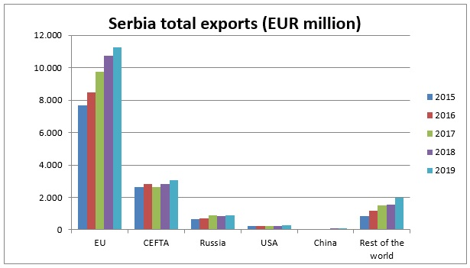
Serbia total exports 2015-2019
Source: The Delegation of the European Union (EU) to the Republic of Serbia, Statistical Office of the Republic of Serbia and Eurostat Comext

Slide 8
Agriculture and the agro-industrial sector
Cooperation shall notably aim at modernising and restructuring the agriculture and agro-industrial sector
to reach community sanitary requirements
to improve water management and rural development
75% of the trade in the field of agriculture is completely liberalized
unrestricted access of industrial and agricultural products to the EU market
except for just a few products that are under tariff quota regime: beef, sugar, a few types of fish and wine).

Slide 9
Further reading
S. Mojsovska (2019) ‘The Western Balkans on its path to the European Union’, Yearbook of the Institute of East-Central Europe, vol. 17, no. 4, pp. 9-24, DOI: https://doi.org/10.36874/RIESW.2019.4.
Baldwin, R., Wyplosz, C. (2004). The Economics of European Integration, McGrawHill, London.
Senior Nello, S. (2009). The European Union: Economics, Policy and History, McGraw-Hill, London.
Jovanović, M. (2004). Evropska ekonomska integracija, Ekonomski fakultet u Beogradu, Beograd.
Budimir, B. Međak (2017). Vodič kroz pristupanje Srbije Evropskoj uniji, 5. dopunjeno izd., ISAC fond, Beograd.

Slide 10
Further reading
Medović, V., Vapa-Tankosić, J. (2017). Izazovi u primeni Sporazuma o stabilizaciji i pridruživanju i pravnih tekovina Evropske unije, Fakultet za ekonomiju i inženjerski menadžment, Novi Sad. ISBN 978-86-87619-90-6.
Medjak, V. (ed.). (2018). Effects of Stabilisation and Association Agreements and CEFTA2006 on WB6 European Integrationand Regional Cooperation: Achievements and Ways Forward. European Movement in Serbia,Belgrade.
European Commission, Serbia 2019 Report, 2019, https://ec.europa.eu/neighbourhood-enlargement/sites/near/files/20190529-serbia-report.pdf

