Slide 1

Jean Monnet Module
Application of EU values in the policies of candidate states / AEUPCS
Jelena Vapa Tankosić
Economic Implications of Regional Integration

Slide 2
Economic Implications of Regional Integration
Numerous theoretical and empirical studies have shown the economic benefits that have been achieved in certain phases of integration.
The benefits of REI are usually achieved in the long run.
The costs are usually a prerequisite for the later economic benefits.
REI have different levels from the mildest to the most developed.
From preferential trade agreements, partial customs unions, free trade zones, customs unions, the common market to partial economic union as the ultimate goal of economic and monetary union.

Slide 3
Economic Implications of Regional Integration
The positive effects of economic integration
economies of scale
increased competition and resource allocation efficiency
production specialization
improved access to innovation
reallocation of production and trade, greater efficiency and production in general,
as well as increased competitiveness in the overall integrated economic space and unified foreign trade policy and tariff towards third countries.

Slide 4
Arguments contra PTAs
Trade diversion effect - PTAs can result in imports of goods from a less efficient country at a higher cost, rather than imports from a country at a lower cost.
Discrimination against PTA non-member countries.
Overlap with existing trade agreements with other countries (so-called spaghetti bowl).

Slide 5
Economic Implications of Regional Integration
The process of European integration began as the dominant international political and security solution.
Each new enlargement brought new challenges.
The beginning of integration, from a successful customs union, and through a hard-to-create common and single market, to a monetary and economic union.
Higher levels of integration, and enlargements with new members, make the EU's internal functioning more difficult.

Slide 6
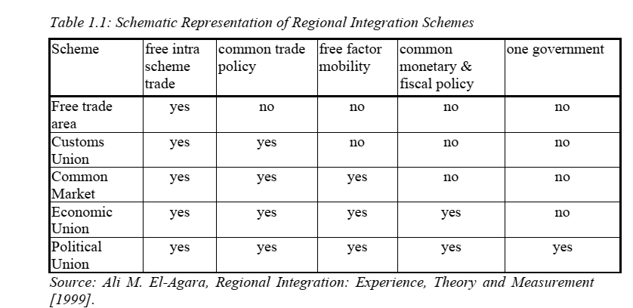
Regional integration schemes

Slide 7
Preferential trade agreement
A preferential trade agreement is an agreement between member states that grants each other various benefits in the field of foreign trade.
Mutual trade of products of the countries that are signatories to the preferential trade agreement is favored in relation to countries that are not Member States.
This is the weakest form of economic integration.
An example of a preferential trade arrangement is the Preferential Scheme of the British Commonwealth, which was founded in 1932 by the United Kingdom with members and some former members of the British Empire.

Slide 8
Free trade area
Free trade area consists in the elimination of all foreign trade barriers in the international movement of goods and services among the members of the zone.
The free trade area represents one of the lowest stages in the development of regional integration because it implies an agreement on trade and exchange of goods between member states without the application of customs duties while each member state independently determines customs duties on imports from non-member countries.
Examples: the European Free Trade Association (EFTA), founded in 1960 by the United Kingdom, Austria, Denmark, Norway, Portugal, Sweden and Switzerland, and the North American Free Trade Agreement (NAFTA) between the USA, Canada and Mexico in 1993. and the Southern Common Market (Mercosur) of Argentina, Brazil, Paraguay and Uruguay in 1991.

Slide 9
Customs Union
Customs Union represents a higher stage in the process of development of regional economic integration and is characterized by an agreement in the direction of abolishing mutual customs duties as well as common tariffs and foreign trade policies that apply to trade with non-member countries.
An example: European Union (EU), or the Common European Market formed in 1957 by West Germany, France, Italy, Belgium, the Netherlands and Luxembourg. Another example is the Zollverein, or customs union, founded in 1834 by a number of independent German states.

Slide 10
Common market
Then we gradually come to the common market which implies integration of not only the goods market but also the labor and capital markets between the member states with the adoption of certain common policies as well as the mobility of factors of production.
goes beyond the customs union by allowing the free movement of labor and capital between member states.
Example: The EU reached common market status in early 1993.

Slide 11
Economic union
Economic union goes even further by harmonizing, or even harmonizing, monetary policy and fiscal policy between member states.
This is the most advanced form of economic integration.
Example: Benelux, which represents the economic union of Belgium, the Netherlands and Luxembourg, which was formed after the Second World War.
Monetary union: EU-adoption uf euro (19 member states)
Presupposes common policies in certain domains or full harmonization, harmonization of different regulations between member states, as well as a common currency, a central bank and a common economic policy.

Slide 12
Complete Political Union
Complete Political Union – occurs when two or more member states unite to form a sovereign nation under one federal or centralized institutional structure
Example: the unification of the East and West Germany.

Slide 13
Further reading for discussion
Viner, J. (1950). The customs union issue. New York: Carnegie Endowment for International Peace.
Meade, J. (1955). The Theoryof Customs Unions. Amsterdam: North-Holland.
Lipsey, R.G. (1961). The Theory of Customs Unions: A General Survey, Economic Journal, pp. 498-513.
Balassa, B. (1961). The theory of economic integration. Homewood, Ill: R.D. Irwin.
Balassa, B. (1974). Trade Creation and Trade Diversion in the European Common Market: An Appraisal of the Evidence, The Manchester School, pp. 93–135.

Slide 14
Further reading
Baldwin, R.E, Venables, A.J. (1995). Regional Economic Integration, In G.M. Grossman, K. Rogoff, eds., Handbook of International Economics,Vol. III (Amsterdam: Elsevier, 1995), pp. 1598-1644.
Jovanović. M (2006). ‘Customs Unions’, in Miroslav N. Jovanović, The economics of international integration, Cheltenham: E. Elgar, pp.28-155
Krugman, P.R., Obstfeld, M., Melitz, M. (2012). International Economics, 9th Ed., Boston :Addison-Wesley [ISBN: 9780132146654]
Salvatore, D. (2013). International Economics, 11th Ed., USA: Wiley. [ISBN: 1118177932]

