Slide 1


Human Rights Protection in the European Union

Slide 2
Jurisprudence of European Court of Human Rights: Establishment and development of the Court; Reforms of the Court; Procedure before the Court; Jurisprudence of the Court; Minimal standards of the human rights protection
Doc. dr Marijana Mladenov
E-mail: alavuk@pravni-fakultet.info

Slide 3
47 European countries – State Parties to the ECHR
830 million people can bring a case to the ECtHR
17.000 judgments have been implemented

Slide 4
The European Court of Human Rights is a permanent regional human rights judicial body in Strasbourg, created under the auspices of the Council of Europe.
The Court was established in 1959.
It handles complaints regarding human rights violations, lodged by individuals or groups of individuals against a member state as well as complaints made by a member state against another member state
In 1998, the European human rights system was reformed to eliminate the European Commission of Human Rights, which previously decided the admissibility of complaints, oversaw friendly settlements, and referred some cases to the Court.

Slide 5
Judges to the Court
Single-judge formation
The Grand Chamber of 17 judges
Three-judge Committees
Seven-judge Chambers

Slide 6
TWO TYPES OF APPLICATIONS
- individual applications (lodged by any person, group of individuals, company or NGO claiming to be the victim of a violation by one of the Contracting Parties of the rights set forth in the Convention or the protocols)
inter-state applications (brought by one State against another – any Contracting Party may refer to the Court any alleged breach of the provisions of the Convention and the protocols by another High Contracting Party)

Slide 7
Two main stages of the procedure
ADMISSIBILITY STAGE
(certain requirements must be met)
MERITS STAGE
(examination of the complaints / actual violations of rights from the convention)

Slide 8
Admissibility conditions
the application must be brought against a state which has ratified the convention (not against any third State or against an individual)
the application must concern an event that occurred after the ratification of the convention by the state concerned
domestic remedies must be exhausted
an applicant’s allegations must concern one or more of the rights defined in the Convention
applications must be lodged within six months following the last judicial decision in the case
the applicant must be, personally and directly, a victim of a violation of the Convention
the applicant must have suffered a significant disadvantage

Slide 9
If the Court has found a member state guilty of violating the human rights as defined in the European Convention on Human Rights (ECHR), the offending state hast to:
pay material damages to the applicant in accordance with the Court’s orders
eliminate the ramifications of the violation
take the necessary steps to insure that the same kind of violation can’t be repeated in the future
publish the judgement in the relevant national legal journals
The judgments of the Court are made public.

Slide 10
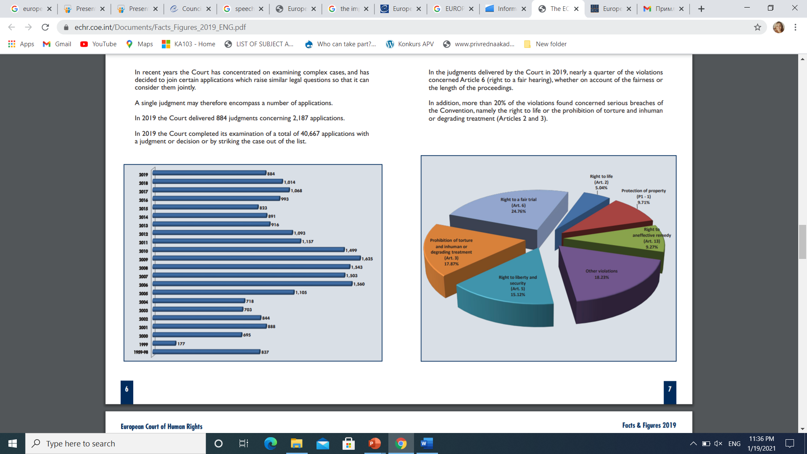
Subject-matter of the Court’s violation judgments (2019)
Source: The ECHR in facts and figures 2019

Slide 11
ECHR aims to offer a minimum standard of protection of human rights
It provides « a floor » for the protection of human rights, not «a ceiling »
States have to comply with this minimum standard, but of course they can go further.
“nothing in this Convention shall be construed as limiting or derogating from any of the human rights and fundamental freedoms which may be ensured under the laws of any High Contracting Party or under any other agreement to which it is a Party“ Article 53 of the ECHR

Slide 12
Discussion topics
European Court of Human Rights - a pan-European supreme court?
The European Court of Human Rights as a Developer of the General Doctrines of Human Rights Law

Slide 13


